Slide 1

RC Primer: Incredibly Easy Parallelization with High Throughput Computing

Slide 2

Incredibly Easy Parallelization with High Throughput Computing
Date: March 19, 2024
Instructor: Andrew Monaghan
Contributors: Layla Freeborn, Trevor Hall, Brandon Reyes
Website: www.rc.colorado.edu/rc
Documentation: https://curc.readthedocs.io
Helpdesk: rc-help@colorado.edu
Survey: http://tinyurl.com/curc-survey18
Slides
https://github.com/ResearchComputing/easy_parallelization_htc_primer

Slide 3
Learning Objectives and Outline
Introduction to high throughput computing (HTC)
HTC method 1: Job Arrays
HTC method 2: Load Balancer
HTC method 3: gnu_parallel
Open Science Grid

Slide 4
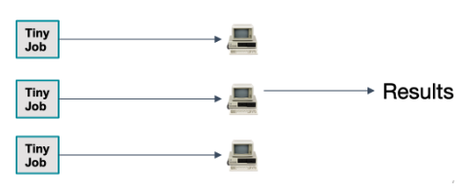
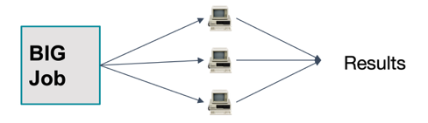
What is High Throughput Computing (HTC)?
Internal parallelization
External parallelization
Example: Climate Model
Example: Image processing
This is HTC!

Slide 5
Three HTC methods for Alpine
 | Job Arrays | Load Balancer | GNU Parallel
Job length? | Best for tasks > 10 min | Best for tasks < 30 min | Best for tasks < 30 min
Where can I use? | Alpine, other HPC resources | Alpine, other HPC resources | Alpine or your laptop/desktop
Max jobs in queue? | 1000 (per array) | No | No
Max cores per job? | None; works well one one or multiple nodes | None; works well on one or multiple nodes | None but works best on one node/machine
Max cores per task? | None | None but most commonly used for serial tasks | None but most commonly used for serial tasks
Does it reserve a controller core? | No | Yes | No
Other features? | Easy to adapt a "regular" job script to accommodate job arrays | Works well for input files with heterogeneous names ; easy to set up multi-node jobs | Great for replacing/speeding up loops; Can pick up where you left off if job times out;
Now let’s try some examples….

Slide 6
Logging into CU Research Computing
login to CURC via your terminal:
…or login to CURC via your browser:
https://ondemand-rmacc.rc.colorado.edu
(once logged in, navigate to Clusters -> Alpine shell)
$ ssh monaghaa@login.rc.colorado.edu
Additional information:
https://curc.readthedocs.io/en/latest/access/logging-in.html
https://curc.readthedocs.io/en/latest/gateways/OnDemand.html
Notes:
sinteractive --partition=atesting --qos=testing --time=90:00 --ntasks=1

Slide 7
Download the example files
]$ cd /scratch/alpine/$USER
]$ git clone https://github.com/ResearchComputing/easy_parallelization_htc_primer
]$ cd easy_parallelization_htc_primer/examples
]$ ls
cars_mpg_array.sh cars_mpg_input_args_array.txt cars_mpg_input_commands_lb.txt cars_mpg.py
cars_mpg_gnuparallel.sh cars_mpg_input_commands_gnuparallel.txt cars_mpg_lb.sh
]$ cat cars_mpg.py
import sys
car=sys.argv[1]
mpg=sys.argv[2]
print("The " + car + " gets " + mpg + " mpg.")
Notes:
sinteractive --partition=atesting --qos=testing --time=90:00 --ntasks=1

Slide 8
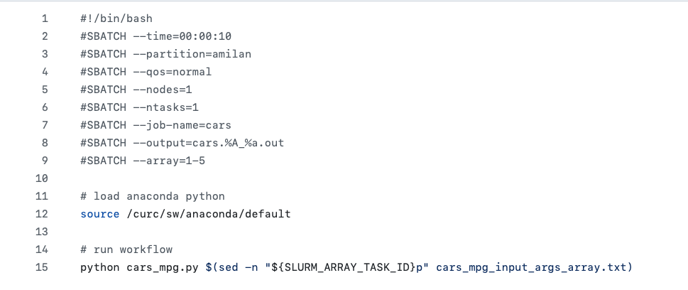
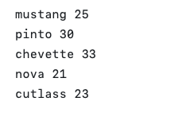
Method 1 Example: Job Arrays
To run this example :
cars_mpg_array.sh (job script)
]$ sbatch –reservation=htc cars_mpg_array.sh
Only request resources for 1 member
cars_mpg_args_array.txt
(arguments)
This flag makes the array
Notes:
sinteractive --partition=atesting --qos=testing --time=90:00 --ntasks=1

Slide 9
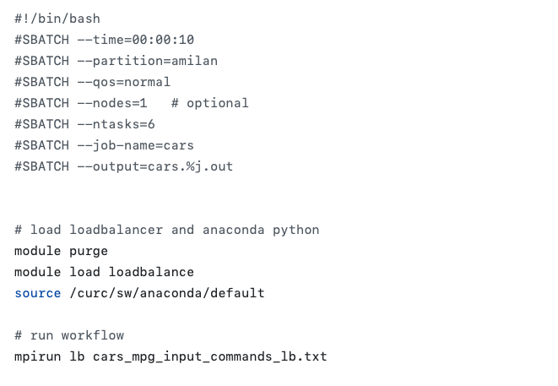
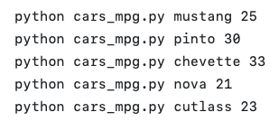
Method 2 Example: Load Balancer
To run this example :
cars_mpg_lb.sh (job script)
]$ sbatch –reservation=htc cars_mpg_lb.sh
Request resources for all members
cars_mpg_commands_lb.txt
(arguments)
Load the ‘loadbalance’ module
Notes:
sinteractive --partition=atesting --qos=testing --time=90:00 --ntasks=1

Slide 10
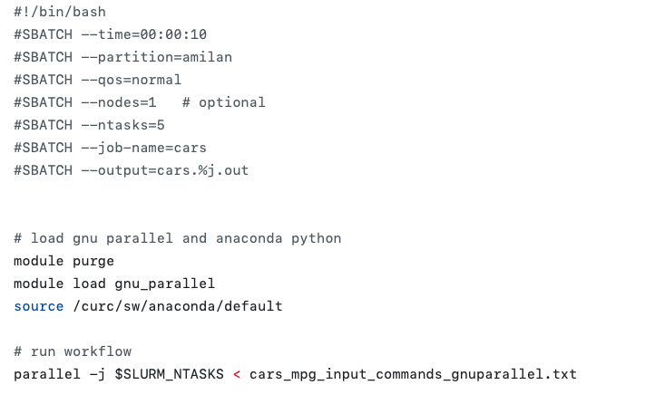
Method 3 Example: GNU Parallel
To run this example :
cars_mpg_gnuparallel.sh (job script)
]$ sbatch –reservation=htc cars_mpg_gnuparallel.sh
Request resources for all members
cars_mpg_commands_gnuparallel.txt
(arguments)
Load the ‘gnu_parallel’ module
Notes:
sinteractive --partition=atesting --qos=testing --time=90:00 --ntasks=1

Slide 11
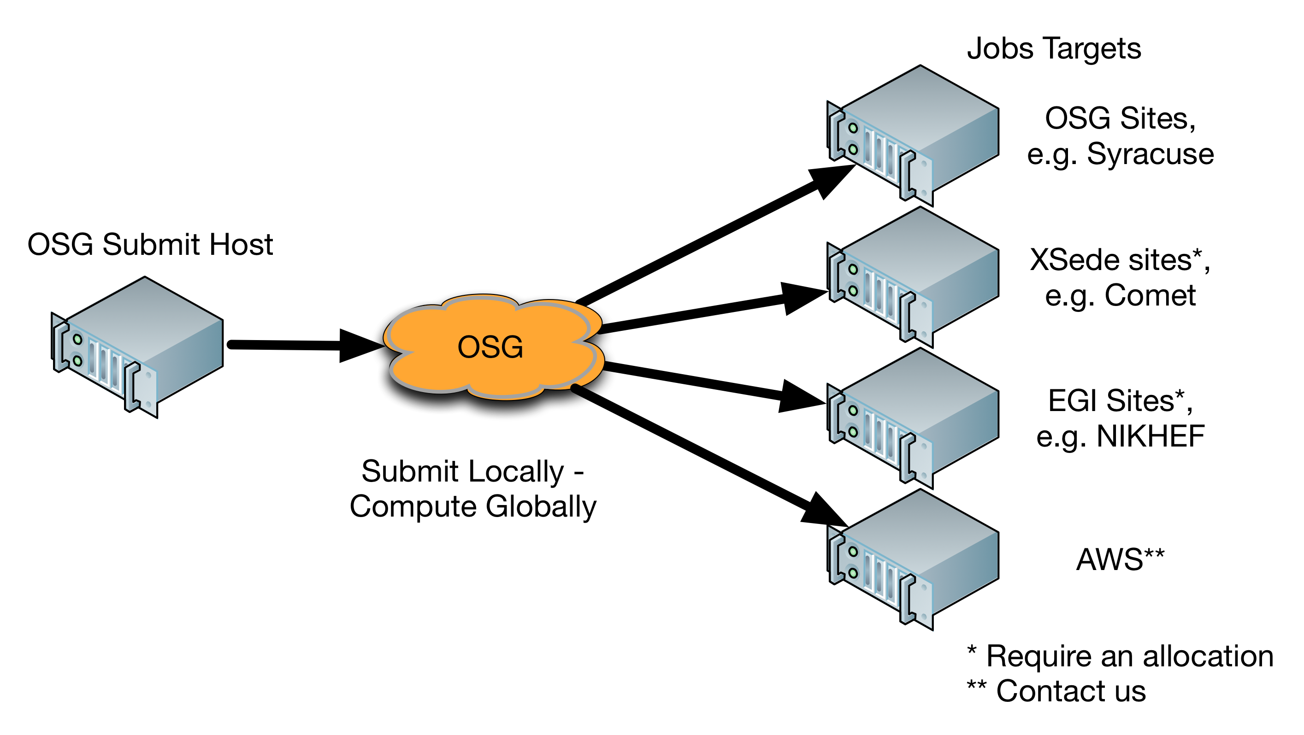
A Community HTC Resource beyond Alpine: Open Science Grid (OSG)
NSF/DOE-funded service (free!)
Open to any U.S.-based researcher
125 institutions sharing spare computing cycles
~1 Billion core hours per year used
Can get started quickly. Options for dedicated allocation if needed.
https://osgconnect.net
Source: https://swc-osg-workshop.github.io/OSG-UserTraining-JLab-2019/materials/AHM/01-IntroGrid.html

Slide 12

Thank you!
http://tinyurl.com/curc-survey18
Survey and feedback

